Slide 1


Chinook Music Analysis
Saran Arul Yogan
28/10/2024

Slide 2





Digital Music Store
Extensive Library
Personalized Experience
The app features a vast music library across various genres, enabling users to discover both popular and lesser-known track
Chinook Music simulates a digital music store, allowing users to browse and purchase tracks and albums easily.
Chinook Music offers personalized recommendations based on user preferences, enhancing music discovery and fostering customer loyalty.

Slide 3

Project Aim
To analyse music record sales data to gain insights and make recommendations for the company's strategy in the physical music market.

Slide 4

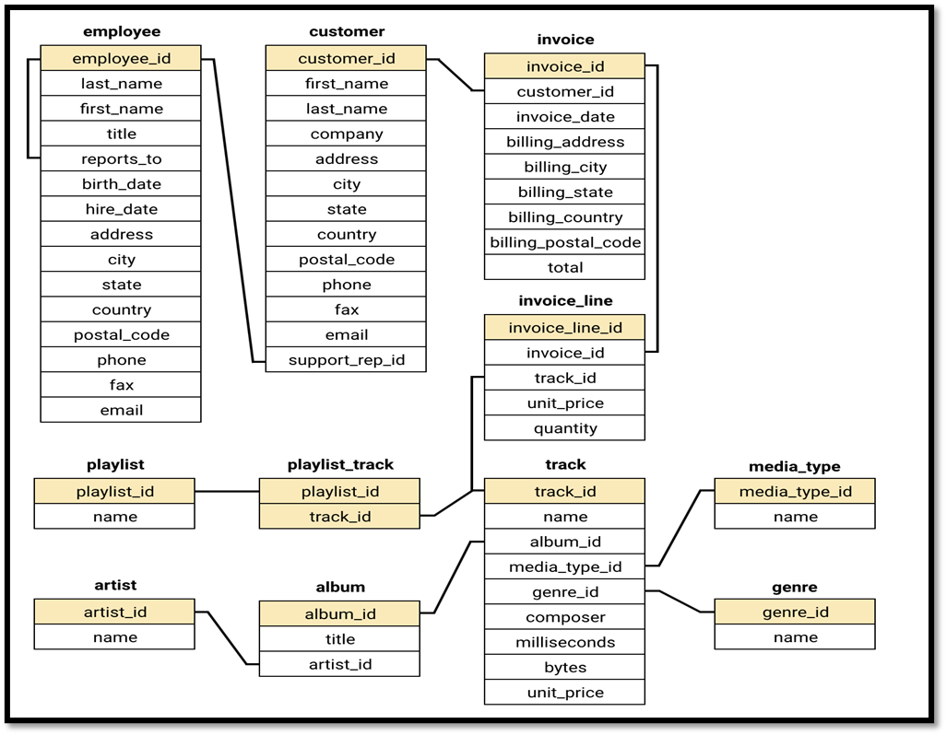
Database Schema

Slide 5

Data Overview
customer
customer_id: Unique identifier assigned to each customer.
first_name: The given name or first name of a customer.
last_name: The surname or family name of a customer.
company: The name of the company associated with a customer.
address: The street address of a customer's location.
city: The city where a customer is located.
state: The state or province where a customer is located.
country: The country where a customer is located.
postal_code: The postal or zip code of a customer's address.
phone: The phone number of a customer.
fax: The fax number associated with a customer.
email: The email address of a customer.
support_rep_id: The employee ID of the support representative assigned to a customer.
invoice
invoice_id: Unique identifier assigned to each invoice.
customer_id: The customer ID associated with the invoice.
invoice_date: The date when the invoice was generated or issued.
billing_address: The street address used for billing purposes.
billing_city: The city used for billing purposes.
billing_state: The state or province used for billing purposes.
billing_country: The country used for billing purposes.
billing_postal_code: The postal or zip code used for billing purposes.
total: The total amount due on the invoice.

Slide 6
invoice
invoice_id: Unique identifier assigned to each invoice.
customer_id: The customer ID associated with the invoice.
invoice_date: The date when the invoice was generated or issued.
billing_address: The street address used for billing purposes.
billing_city: The city used for billing purposes.
billing_state: The state or province used for billing purposes.
billing_country: The country used for billing purposes.
billing_postal_code: The postal or zip code used for billing purposes.
total: The total amount due on the invoice.
invoice_line
invoice_line_id: Unique identifier assigned to each line item on an invoice.
invoice_id: The invoice ID to which the line item belongs.
track_id: The ID of the track or product included in the line item.
unit_price: The price per unit for the line item.
quantity: The quantity of units for the line item.

Slide 7
playlist
playlist_id: Unique identifier assigned to each playlist.
name: The name or title of the playlist.
playlist_track
playlist_id: The ID of the playlist to which the track belongs.
track_id: The ID of the track included in the playlist.
unit_price: The price per unit for the track.
track
track_id: Unique identifier assigned to each track or song.
name: The title or name of the track.
album_id: The ID of the album to which the track belongs.
media_type_id: The ID of the media type associated with the track.
genre_id: The ID of the genre associated with the track.
composer: The name of the composer or artist who composed the track.
milliseconds: The duration of the track in milliseconds.
bytes: The file size of the track in bytes.
unit_price: The price per unit for the track.
album
album_id: Unique identifier assigned to each album.
title: The title or name of the album.
artist_id: The ID of the artist associated with the album.
artist
artist_id: Unique identifier assigned to each artist.
name: The name of the artist.
media_type
media_type_id: Unique identifier assigned to each media type.
name: The name or description of the media type (e.g., MPEG audio file, AAC audio file).
genre
genre_id: Unique identifier assigned to each genre.
name: The name or description of the genre (e.g., rock, pop, classical).

Slide 8

Data Cleaning and Processing
Null Value Identification: Conducted null checks across key tables (employee, customer, and track) using SQL queries to locate missing values in essential columns.
Handling Missing Values: Employed the COALESCE function to replace nulls with appropriate default values, such as "N/A" for company and "Unknown" for state in the Customer table, ensuring data consistency.
Data Integrity: Reviewed all tables to confirm the absence of duplicate rows in primary key columns, maintaining data integrity and reliability.
Usability Preservation: Successfully replaced missing values without altering original records, enhancing the dataset's usability for further analysis and insights.

Slide 9
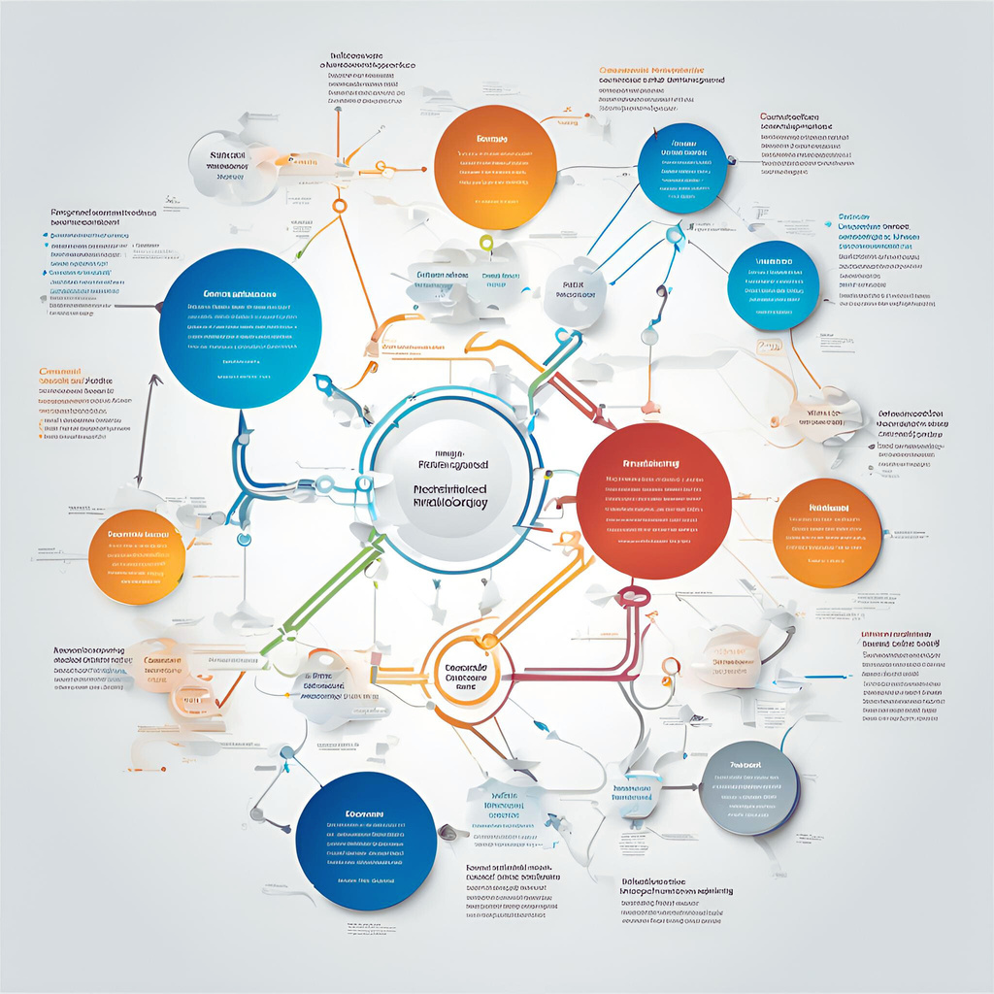
Methodology
Common Table Expressions (CTEs): Utilized CTEs to create temporary result sets, facilitating complex queries and improving code readability by breaking down intricate logic into manageable components.
Subqueries for Data Aggregation: Implemented subqueries to aggregate data, allowing for detailed calculations such as total spending and track counts per customer, enhancing insights into purchasing behaviours.
Group By and Aggregate Functions: Applied GROUP BY clauses alongside aggregate functions (e.g., SUM, AVG, COUNT) to summarize customer data, enabling a comprehensive analysis of average spending and purchase frequency across different segments.
Ordering Results: Employed ORDER BY statements to organize query outputs systematically, ensuring that the final results were presented clearly and highlighted significant findings, such as top-spending customer segments.

Slide 10
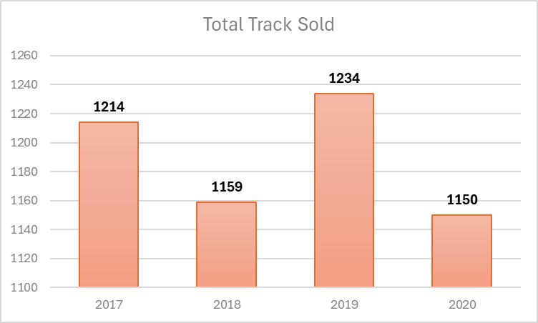
Yearly Track Sales Analysis
Peak Sales in 2019: Highest track sales reached 1,234, likely due to increased demand or effective promotions.
Consistent Sales Trend: Sales remained steady over the years, with only a slight dip to 1,150 in 2020, showing stable customer interest.

Slide 11
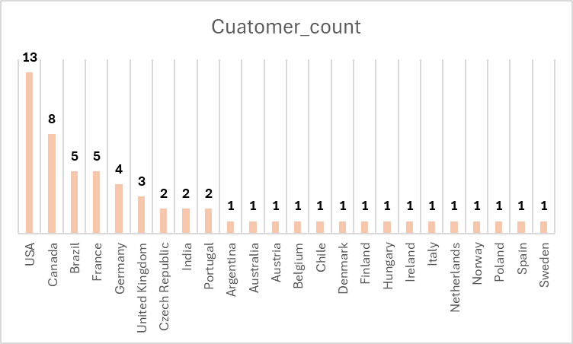
Demographic Distribution
Top Customer Base: The USA leads in customer count, followed by Canada, France, Brazil, and Germany.
Smaller Markets: Countries like Portugal, India, Spain, Belgium, Argentina, and Norway show minimal customer presence, with only 1 or 2 customers each.

Slide 12
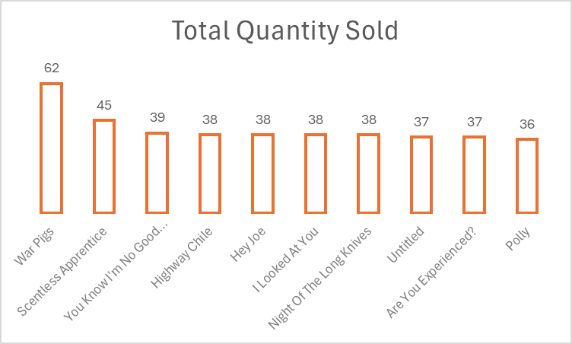
Global Top-Selling Tracks Insights
Top Track: "War Pigs" leads with 247 sales, highlighting its broad appeal globally.
High Demand for Key Tracks: Popular tracks like "Hey Joe," "Are You Experienced?," and "Third Stone From The Sun" also show strong sales (149–177), indicating a solid lineup that resonates widely.

Slide 13
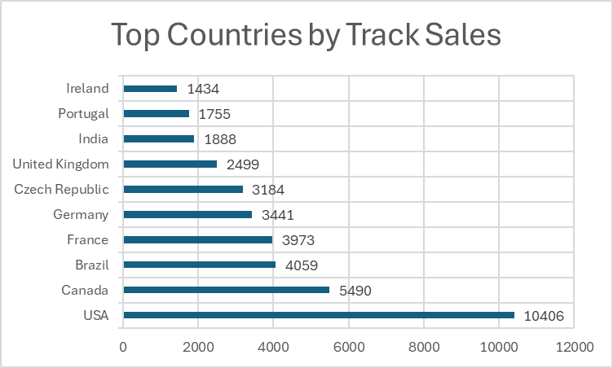
Top Countries by Track Sales
Top Markets: The USA ($10,406 sales), Canada ($5,490), and Brazil ($4,059) are the leading markets.
Broad Global Reach: Notable sales in European countries like France, Germany, and the Czech Republic suggest potential for targeted regional marketing.

Slide 14
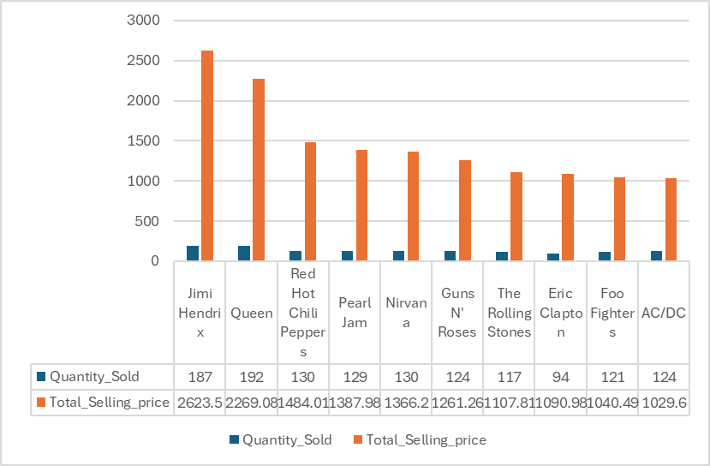
Top Trends in Artist Sales
Top Earner: Jimi Hendrix leads in revenue, selling 187 units and earning $2,623.50, showcasing high demand and strong pricing.
Strong Sales for Rock Legends: Queen and Red Hot Chili Peppers are close contenders, with Queen selling 192 units ($2,269.08) and Red Hot Chili Peppers selling 130 units ($1,484.01).
Classic Rock Demand: Consistent sales from Guns N' Roses, The Rolling Stones, and AC/DC highlight a steady appeal for classic rock artists in the market.

Slide 15
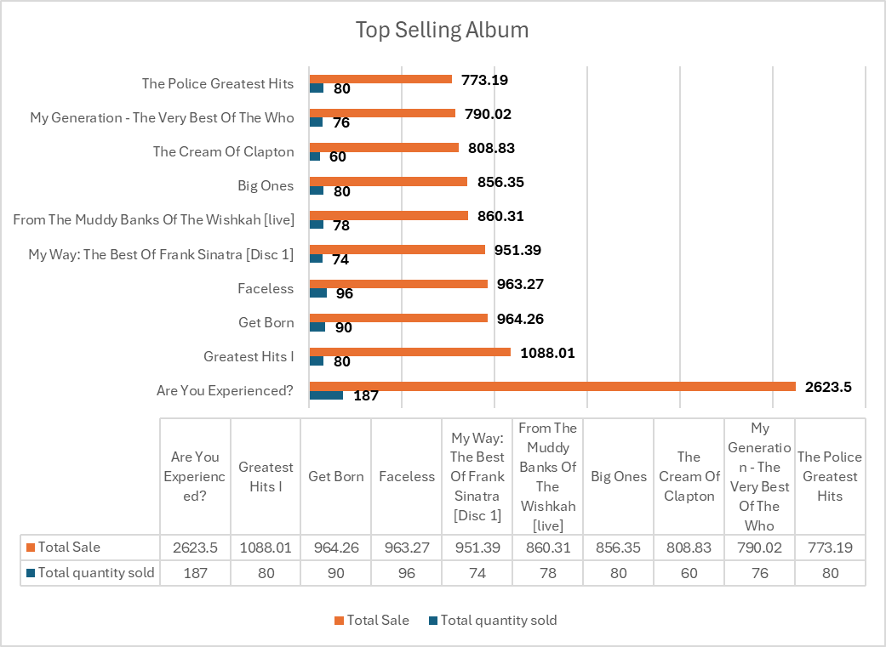
Top-Selling Albums
Strong Sales for "Are You Experienced?": With 2,624 total sales, Are You Experienced? stands out as the top-selling album, indicating its enduring popularity.
High Demand for Greatest Hits: Albums like Greatest Hits I by Queen (1,088 sales) and The Police Greatest Hits (773 sales) reveal a trend where collections of popular tracks attract significant attention.

Slide 16
Genre Popularity Analysis
Rock Dominates: Rock is the leading genre, accounting for over half (53.33%) of total sales, reflecting its strong appeal to a broad audience.
Diverse Tastes in Top Genres: Following Rock, genres like Alternative & Punk (12.36%) and Metal (11.79%) show significant interest, while genres like R&B/Soul (5.04%) and Blues (3.42%) cater to niche audiences.

Slide 17
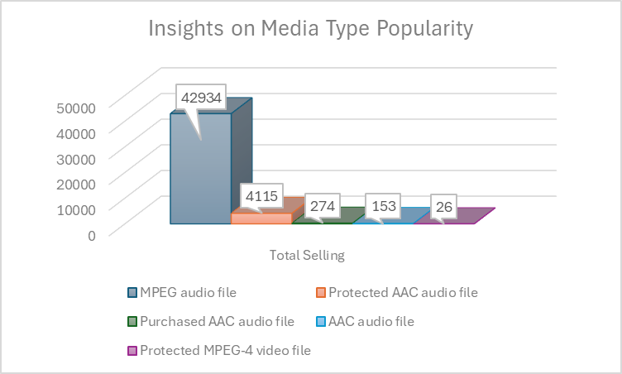
Insights on Media Type Popularity
Dominance of MPEG Audio Files: MPEG audio files are by far the most popular media type, with 42,934 sales, indicating a strong preference for this format among customers.
Low Demand for Video and Protected Formats: Protected MPEG-4 video files and less common audio formats like Protected and Purchased AAC files have significantly lower sales, suggesting limited interest or usage in these formats.

Slide 18
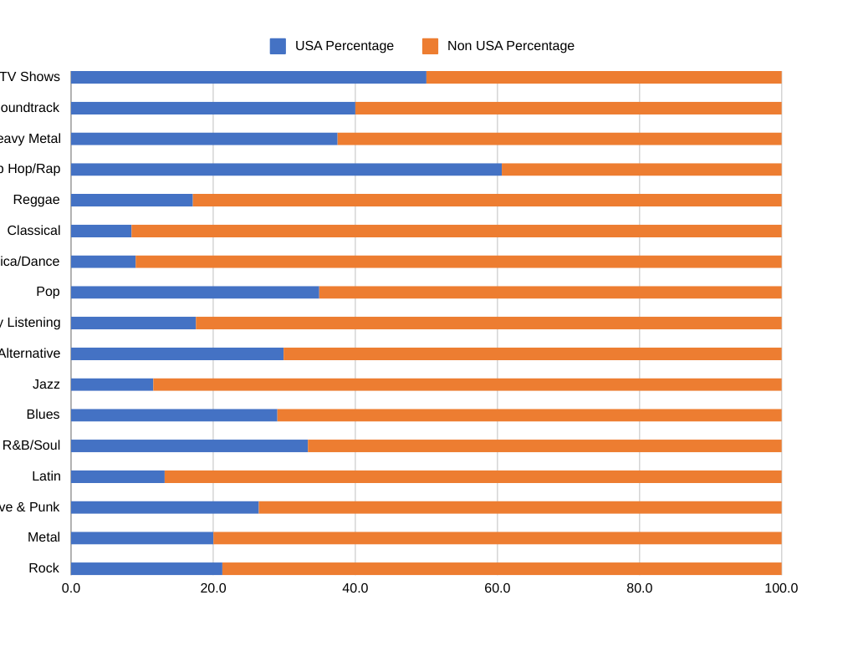
Comparing USA Music Preferences with Global Trends
Strong USA Preference: Hip Hop/Rap leads with 60.61% USA representation, indicating its cultural relevance in the country.
Largest Genre Divide: Hip Hop/Rap shows the greatest difference of 21.22% (60.61% USA vs. 39.39% non-USA), highlighting its dominance in the USA compared to its international appeal.
Low Classical and Jazz Representation: Classical (8.51% USA) and Jazz (11.57% USA) are predominantly appreciated outside the USA, with over 90% of their audiences non-USA.

Slide 19
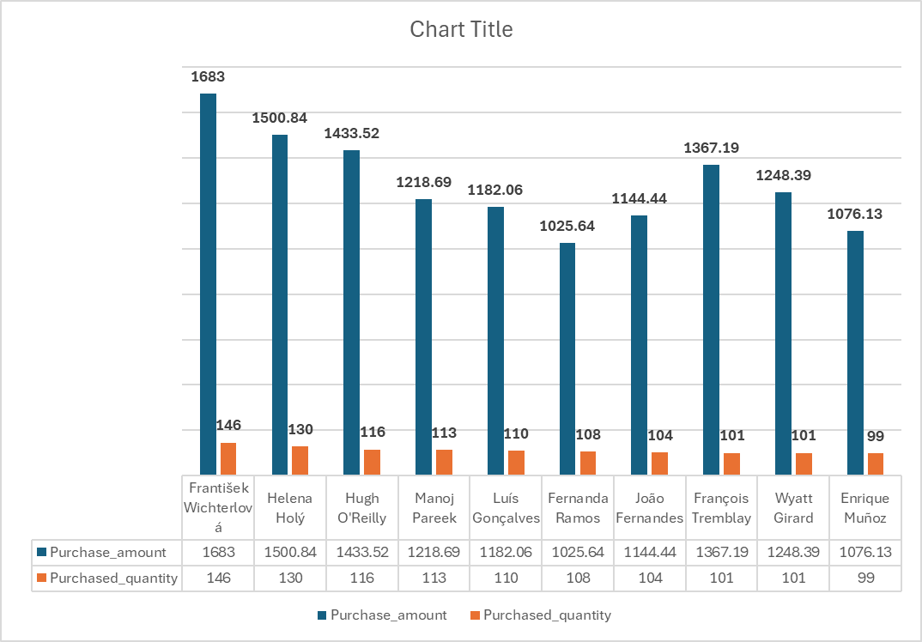
Top 10 Customers with Highest Revenues
The top 10 customers with highest revenues across the world is being displayed in the visual on the left.
The blue bar specifies the total spent by the customer.
The red bar represents the count of tracks sold.
This data can help us understand the purchasing pattern of the customers.

Slide 20
Strategic Insights for Maximizing Music Record Sales
Peak Sales Year: The highest track sales in 2019 (1,234 sales) suggest effective marketing strategies that could be replicated in future campaigns to boost demand.
Dominance of Rock: With rock accounting for over 53% of total sales, companies should focus on promoting rock artists and albums, capitalizing on their widespread popularity.
Leading Artist: Jimi Hendrix, as the top-selling artist (2,624 sales), underscores the potential for re-releases or special editions of his work to drive further sales.
Diverse Global Markets: The USA leads in sales (10,406), followed by Canada and Brazil, indicating the need for tailored marketing strategies in these regions while also exploring growth in European markets.
Format Preferences: The preference for MPEG audio files (42,934 sales) highlights the importance of maintaining and promoting this format, while efforts should be made to understand the limited demand for video and protected formats.

Slide 21
Conclusion
The analysis of music record sales data reveals a robust physical music market, particularly in rock and classic genres, with clear regional preferences and opportunities for targeted marketing. Companies should leverage the popularity of top-performing artists and genres while addressing the declining interest in less popular formats.

